Slide 1
Housing Trends Prediction

Slide 2
Outline
Introduction
Feature Importance using Boruta Package(Random Forest)
Clusters
Models and Comparisons.
Graph plots and Data trends
Summary

Slide 3
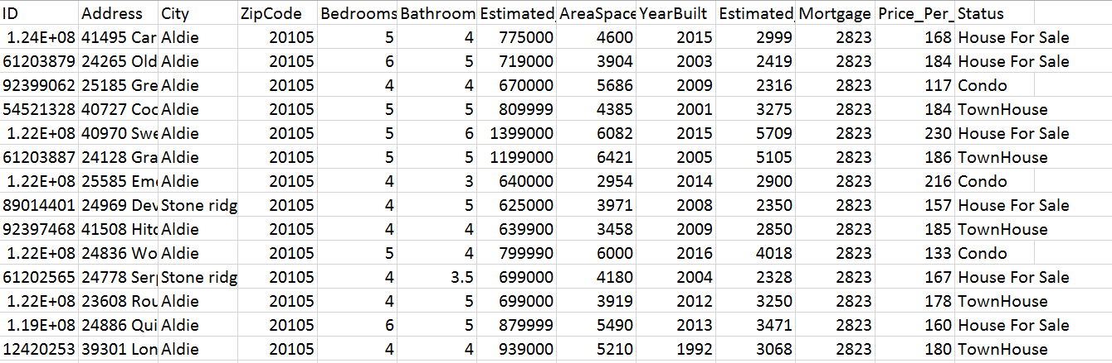
Introduction
Data Set

Slide 4
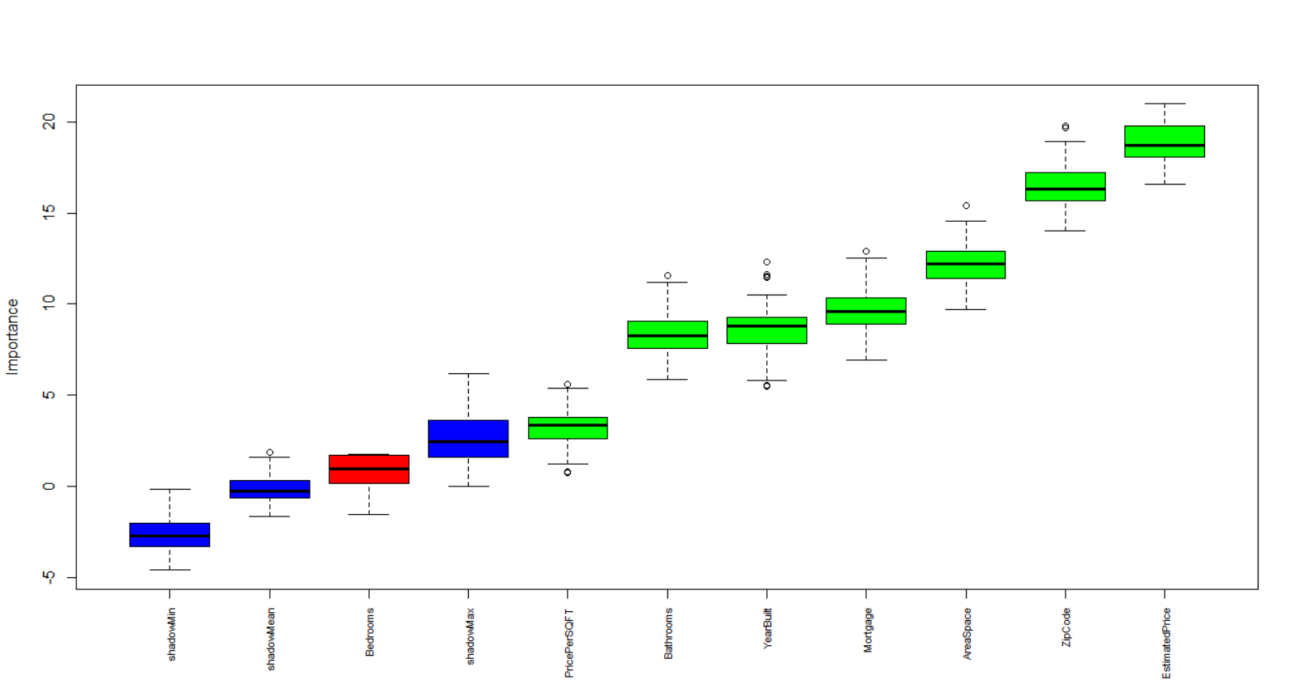
Feature Importance
Boruta Package
Importance Plot

Slide 5
Clustering
EM Clusters
K-Means Clusters

Slide 6
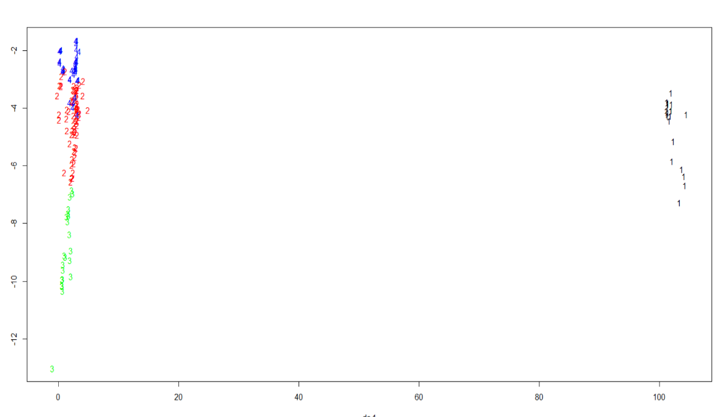
EM Clusters for Condos

Slide 7
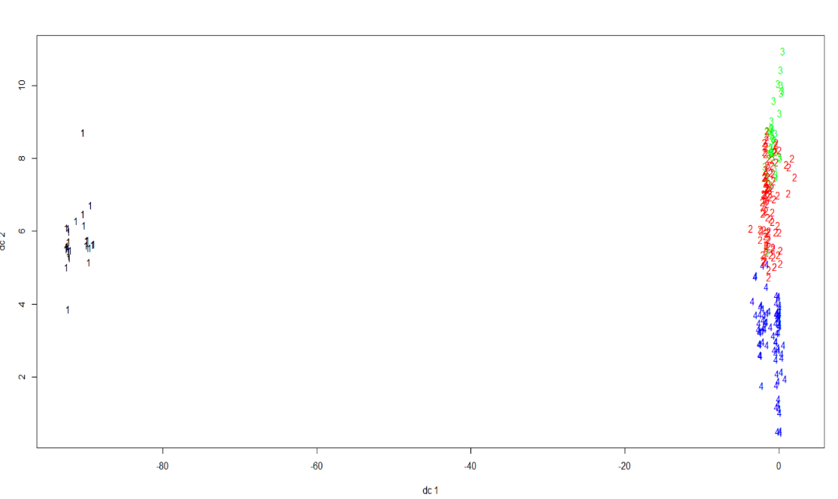
EM Clusters for Townhouses

Slide 8
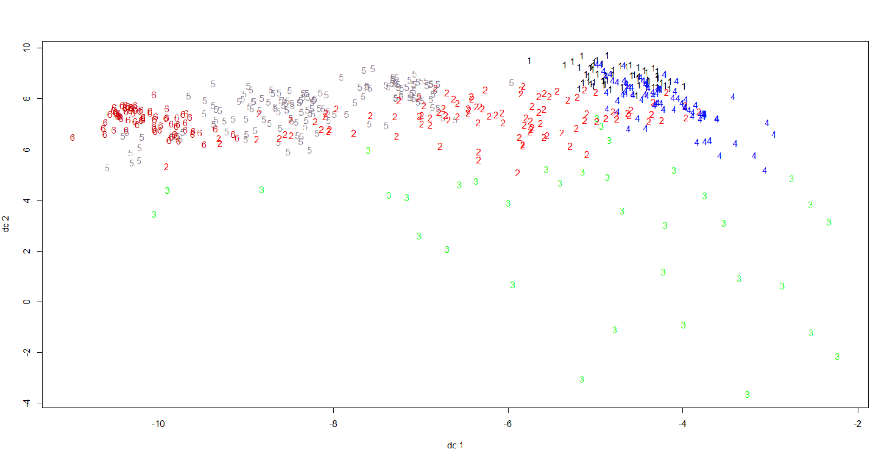
EM Clusters for Houses

Slide 9
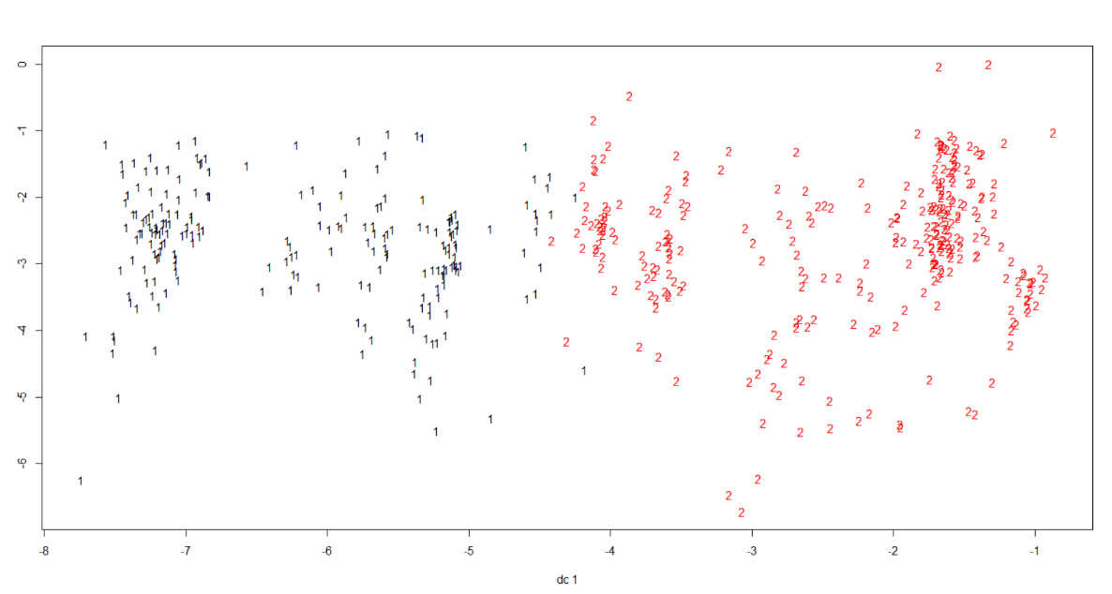
K-Mean Clusters for Houses

Slide 10
Model Algorithms
Multiple Regression
Backward Multiple Regression

Slide 11
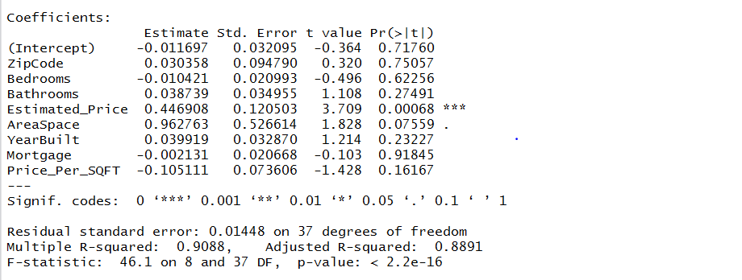
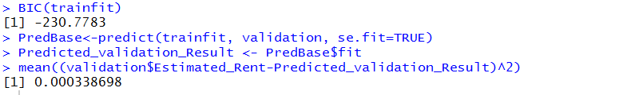
Multiple Regression Results For Houses

Slide 12
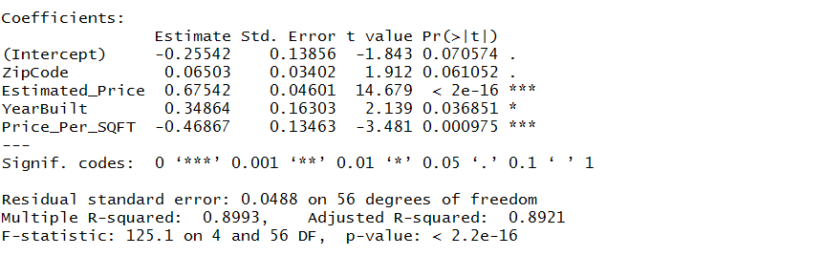
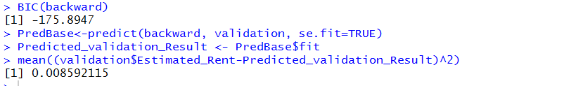
Backward Regression Results For Houses

Slide 13
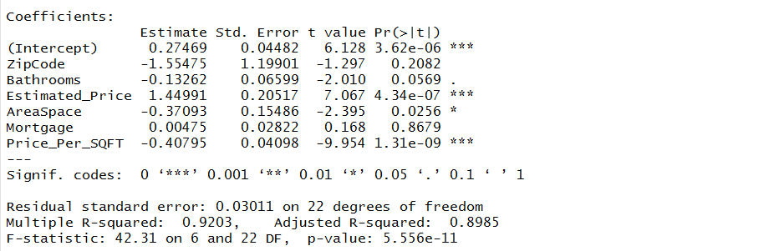
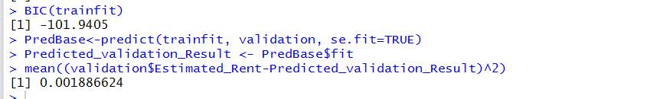
Multiple Regression Results For Townhouses

Slide 14
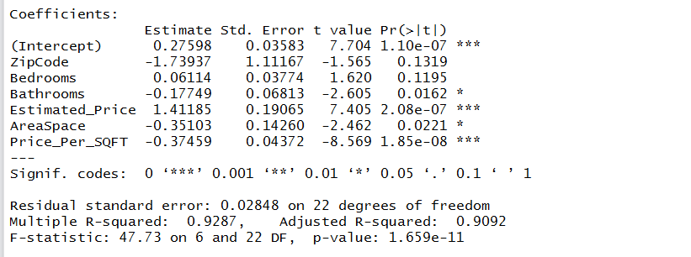
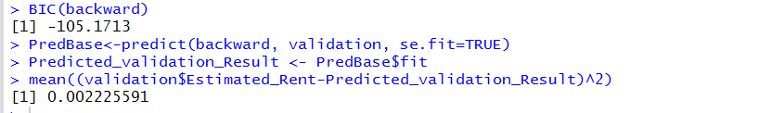
Backward Regression Results For Townhouses

Slide 15
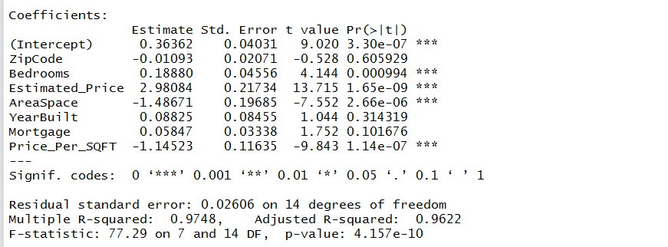
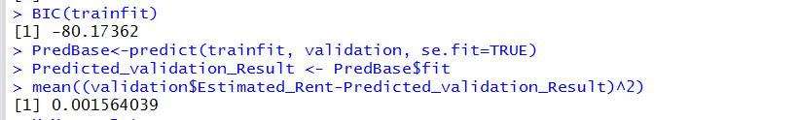
Multiple Regression Results For Condos

Slide 16
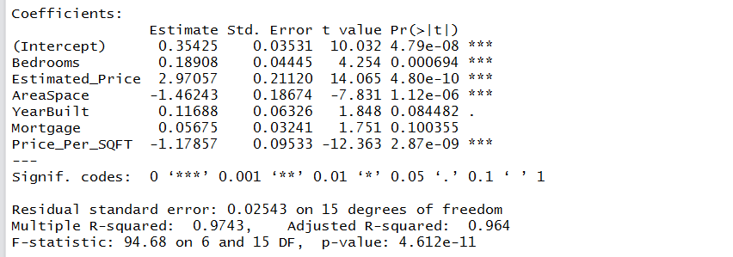
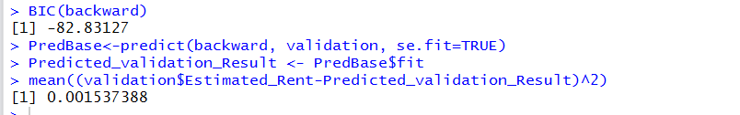
Backward Regression Results For Condos

Slide 17
Graph Plots and Trends

Slide 18
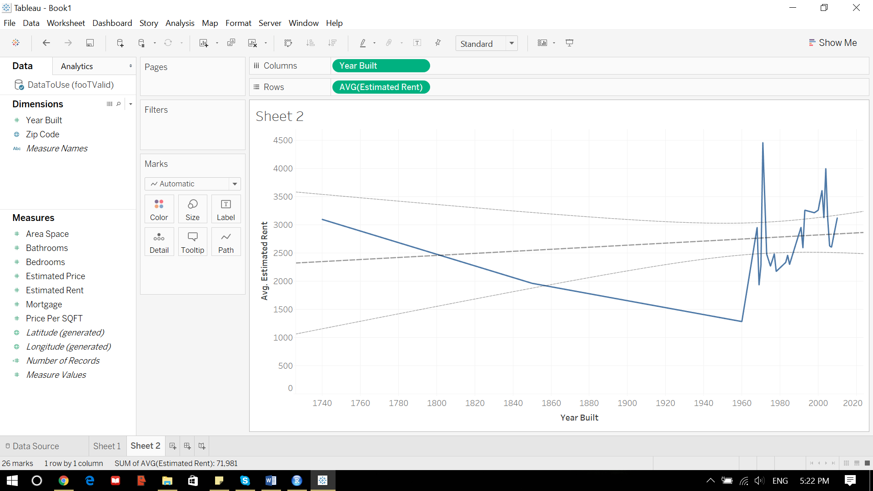
Year Built vs Estimated Rent

Slide 19
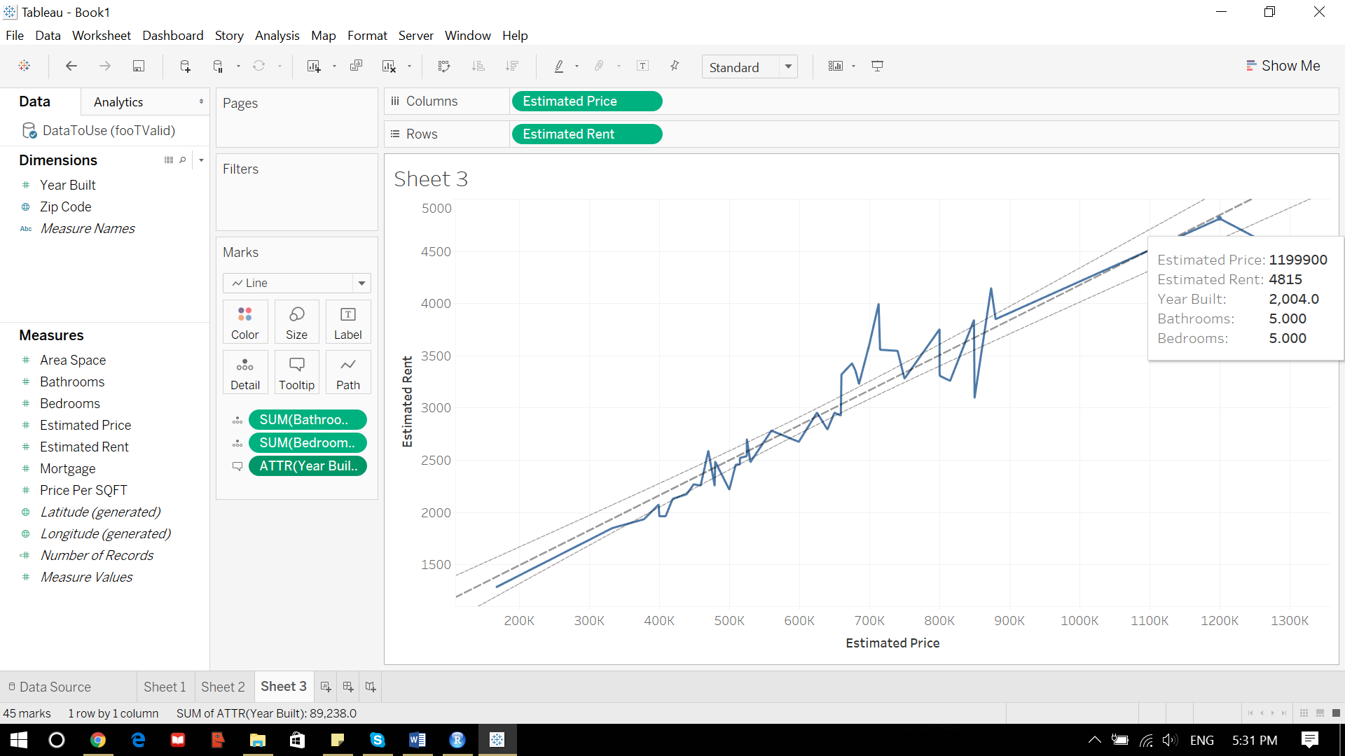
Estimated Price vs Estimated Rent

Slide 20
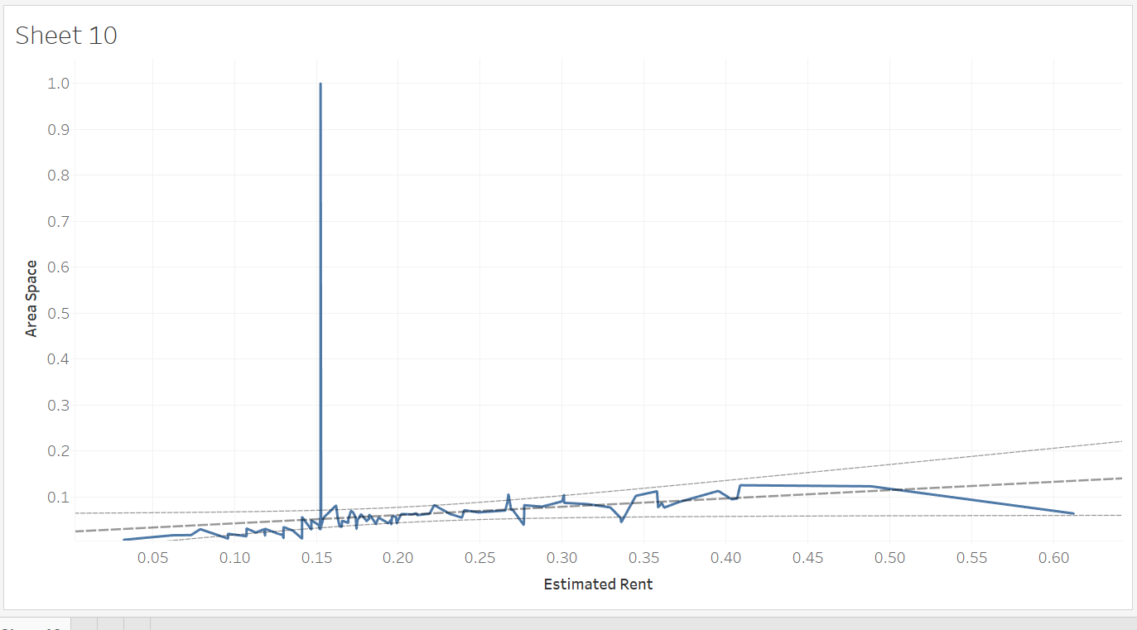
Estimated Rent vs Area Space

Slide 21
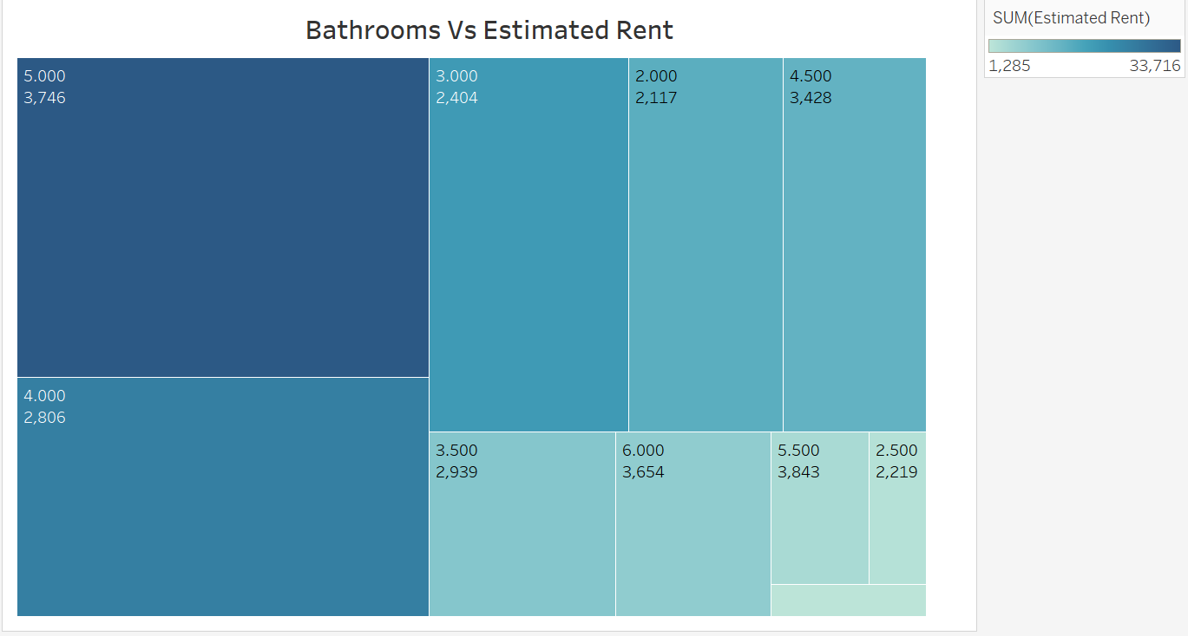
Bathrooms vs Predicted Estimated Rent

Slide 22
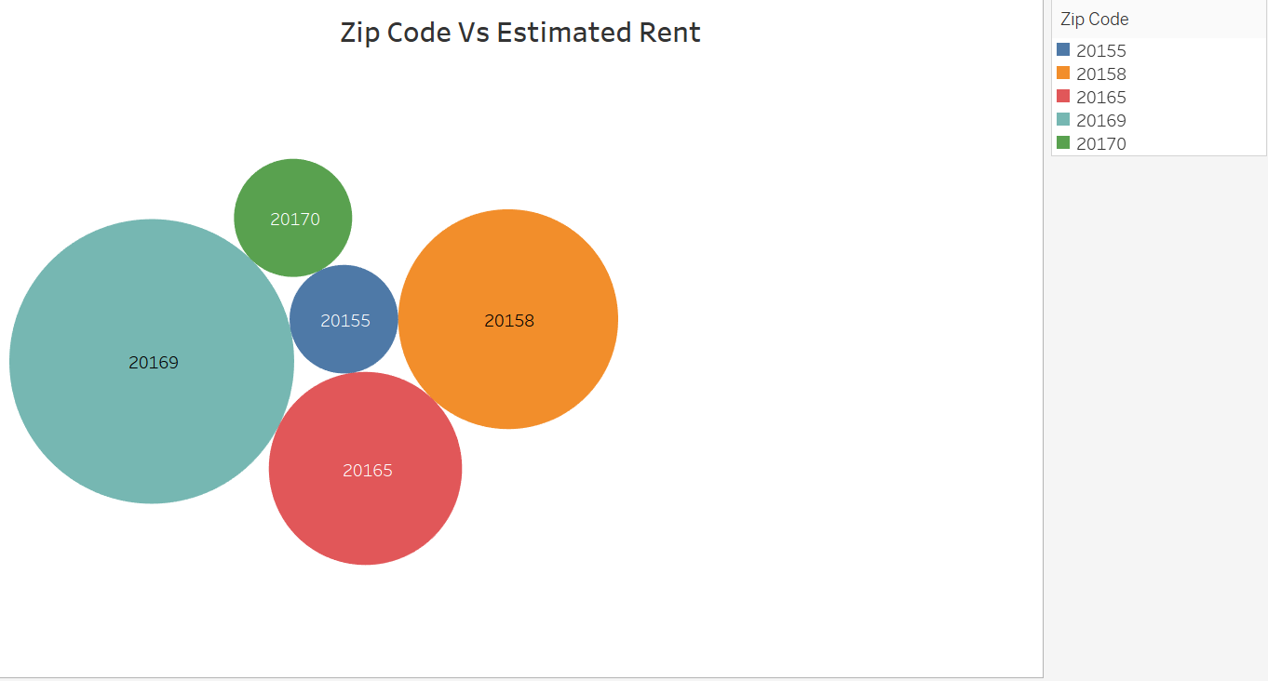
Zip Code vs Predicted Estimated Rent

